Slide 1

Marketing Campaign Guidance
User Guide

Slide 2
Contents
Introduction………………………………………………………………………………………………….3
Overview of the dashboard and Guide…………………………………………………………4
Finding your way around the Guide…………………….………………………………………5
Contents of the pages………………………………………………………………………………….6
Using filters………………………………………………………………………………………………….7
Tips for easy page navigation……………………………………………………………………..8
Data Sources………………………………………………………………………………………………..9

Slide 3
Introduction
In response to a request from the Marketing Department our Data team has put together a Tableau guide to the next cold calling campaign and have provided some useful guidance as to which types of customer might be most receptive to an approach and more likely to take up our offer.
This guidance has been constructed using data obtained from our previous marketing campaign where we made 124,956 calls to 45,211 customers based on a deposit account offering.
It is, by no means, intended to be comprehensive but is strictly to be seen as a guide providing suggestions based on the data, allowing the reader to select various parameters to help decide the best approach to take in any future campaign.
The main aim is to help identify the type of customer who might be most receptive to a new campaign.

Slide 4
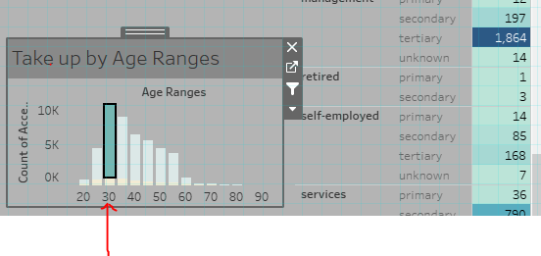
Overview of the dashboard and Guide
The front page (Dashboard) provides high level information to help guide the user around the available information.
The Dashboard is interactive meaning that, by clicking on one of the criteria within one of the visualisations the other visualisations will reflect the values associated with that selection.
To reverse this, click on any other area of the visualisation.

Slide 5
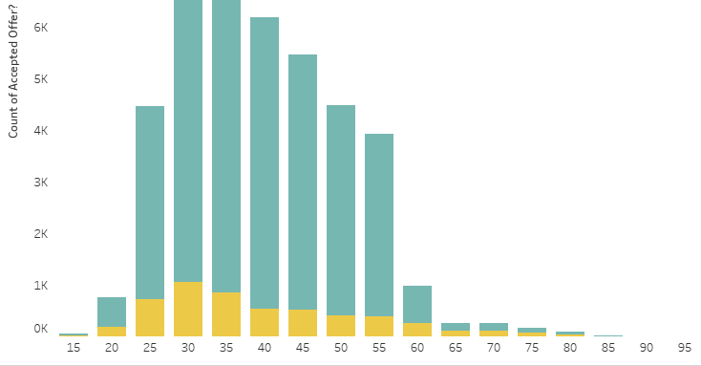
Finding your way around the Guide
It is possible to view a larger version of any of the visualisations by clicking on any of the various ‘sheets’ at the foot of the guide.
This will take you to the actual report -

Slide 6
Contents of the pages
Page 1 – Marketing Campaign – this is the ‘Dashboard’ containing the highlights of the guide and where you can see the relationships between the individual visualisations.
Page 2 – Take up by occupation – shows the number of people who, when contacted, took up our offer and is split into 12 separate occupations (including ‘unknown’
Page 3 – Take up by Education level – shows the penetration rate by education level (between Unknown and tertiary levels)
Page 4 – Take up by marital status
Page 5 – Penetration by occupation (represented by percentages rather than absolute figures)
Page 6 – Take up by credit default - customers with poor credit history
Page 7 – Take up by mortgage – whether customers had home loans
Page 8 – Take up by personal loan – whether the customer had a loan at the time of the call
Page 9 – Take up by age range – split into bands of 5 years
Page 10 – Take up by demographics. Age has been left out to make the figures more meaningful and as they have their own visualisation.

Slide 7
Using Filters
Clicking on one measure of any of the visualisations will amend all other graphics on the dashboard to highlight the selection (see overview)
This enables the user to hone in on any of the several possible variations in the data input to see how this impacts the results.
In this way the user can be more selective and make an informed decision when devising any future marketing campaigns.

Slide 8
Tips for easy page navigation
Select any metric which you think might reveal some more interesting details. The other visualisations will change to suggest further investigation.
The constituent sheets can be selected to reveal larger scale graphics and allow greater detail to be shown.
If you struggle to reset the filters, highlight a section of the dashboard report which does not have any populated field and the report should revert to the full version.

Slide 9
Data Sources
This dashboard and all data therein have been provided by the marketing department based on their recent campaign – ‘Direct_Marketing_Campaign.csv’
No other sources of data have been used in the compilation of this guide.
© A Boyne March 2024

